Slide 1
Stellar Factor
Stargate-inspired Algebra game

Slide 2
01
Systems

Slide 3
Questions
Difficulty scales through level
Respawning
Checkpoint based respawns based off progress
UI Systems
Working Main Menu
Working Pause Mechanics
Minimap

Slide 4
02
Models

Slide 5
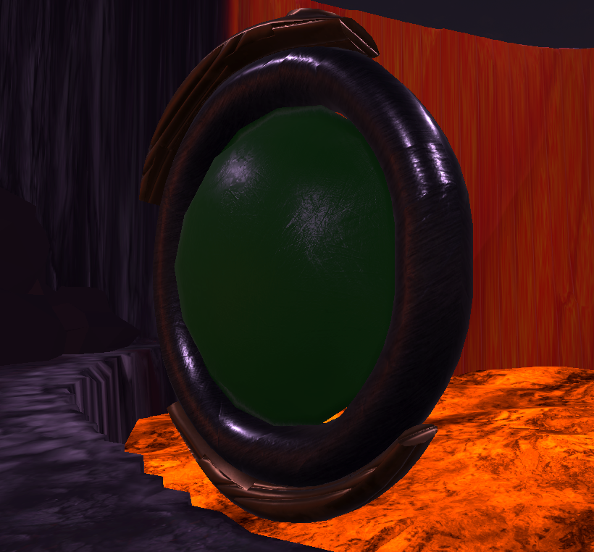
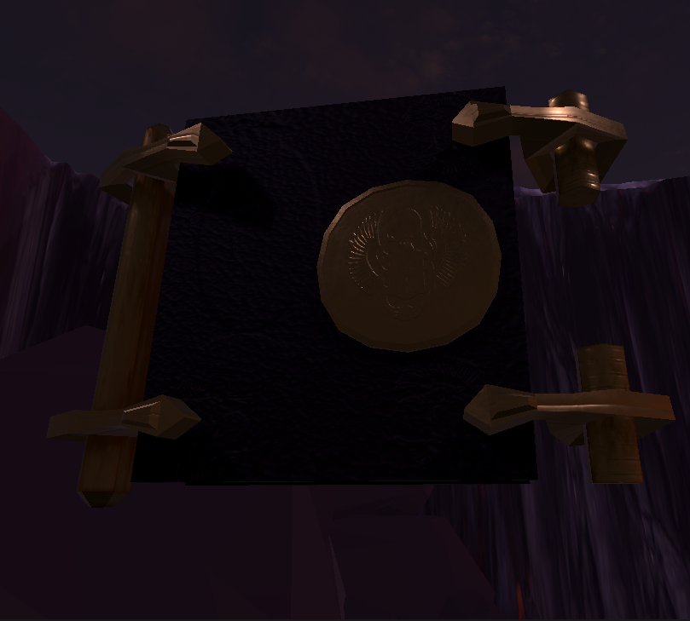
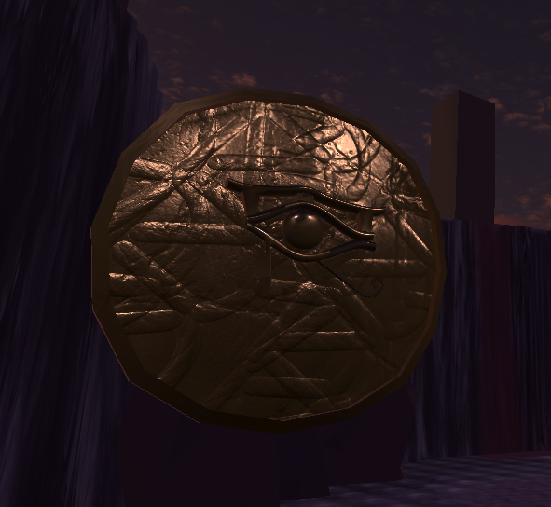
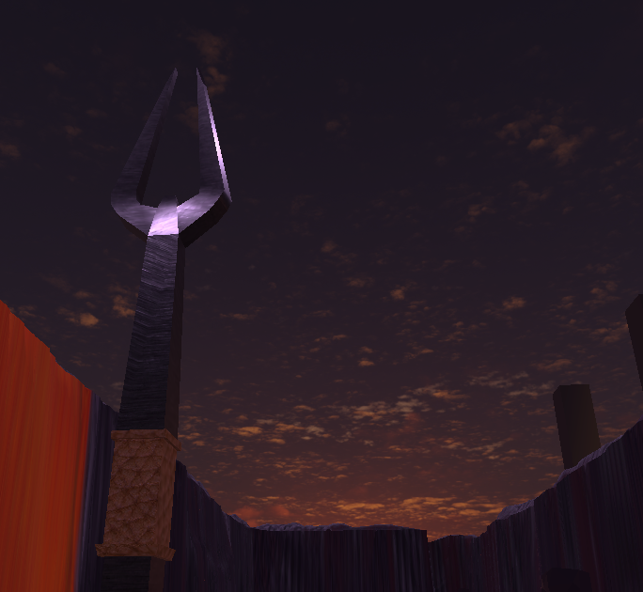


Slide 6
03
UI

Slide 7
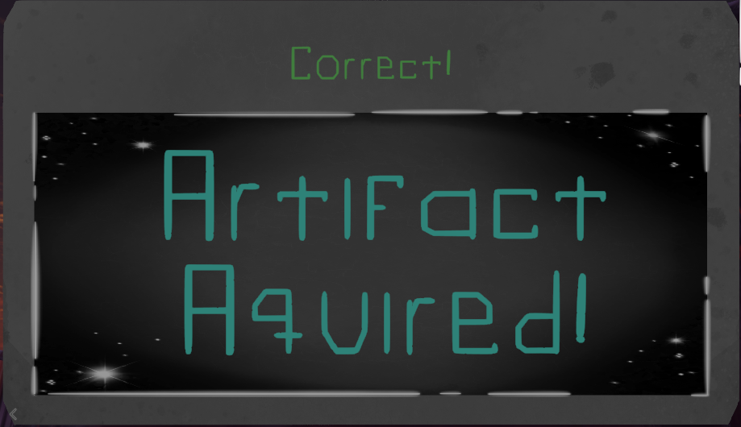
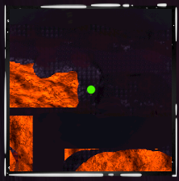
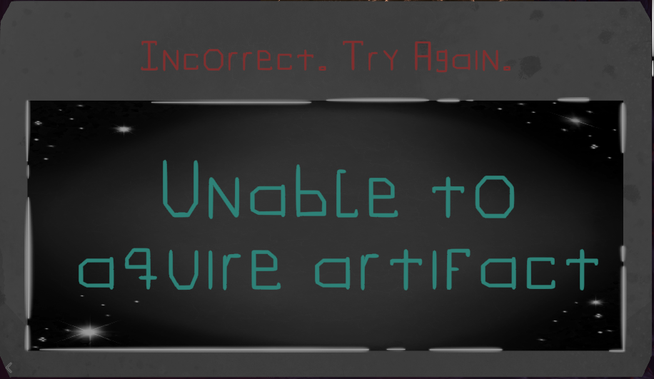
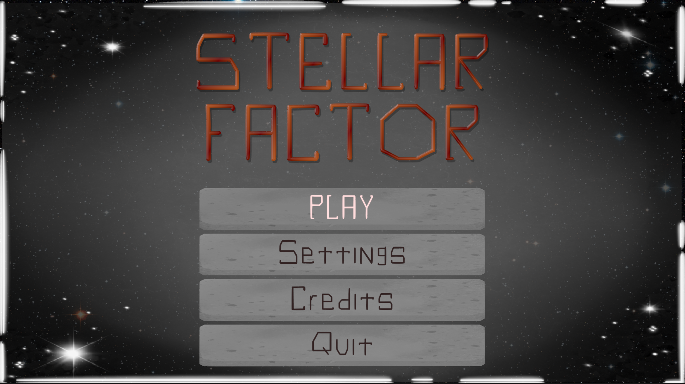
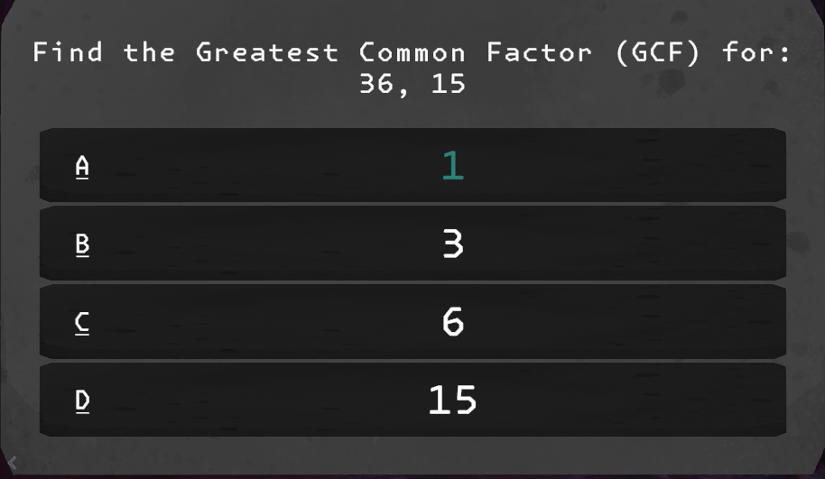


Slide 8
THANK YOU
COMPANY NAME

